Slide 1
Mouse tracking using mpu-6050
A project by:
Sarvesh kale
Shreyas Kulkarni
Shaunak juvekar

Slide 2

introduction
Basic idea
Better alternative

Slide 3
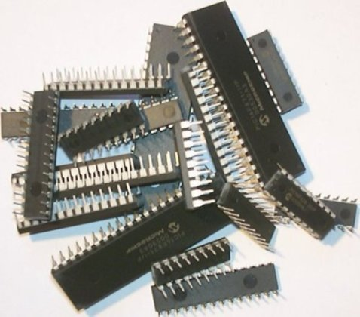
requirements
Gyroscope
Accelerometer
Microcontroller
Console(PC)

Slide 4

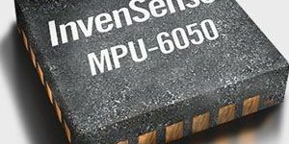
Selected components
MEMS Invensense MPU-6050 module
Arduino Uno (Atmega32P)
Matlab 2015

Slide 5

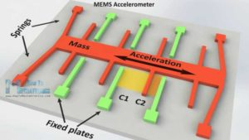
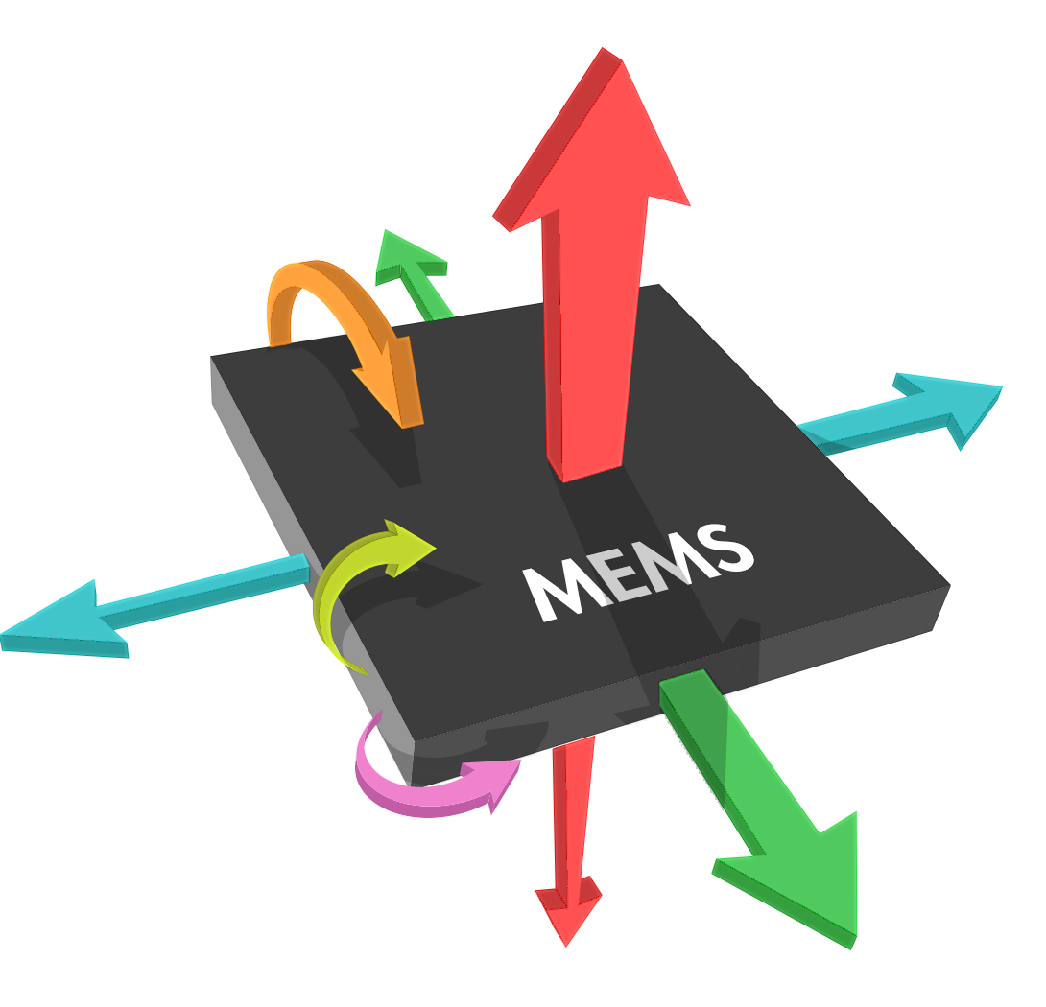
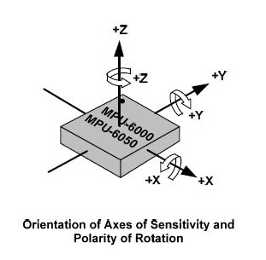
Working principle

Slide 6
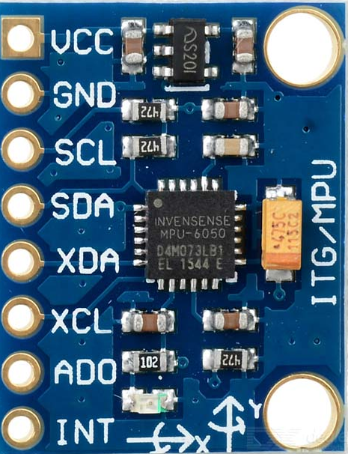

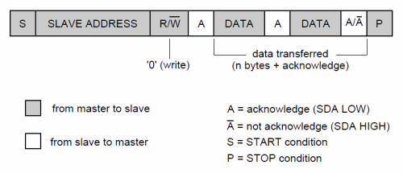
Features of mpu-6050
Miniature IC mounted module
6-axis motion sensing
3-different sensors
Uses I2C protocol
Compatible with Arduino
Inexpensive and easily available

Slide 7
Block diagram
MPU-6050 module
ARDUINO UNO
CONSOLE (PC)& SIGNAL PROCESS
I2C PROTOC--OL
USB

Slide 8

Expected end result
Limitations
Scope for improvement
Thank-you

